Slide 1


Slide 2
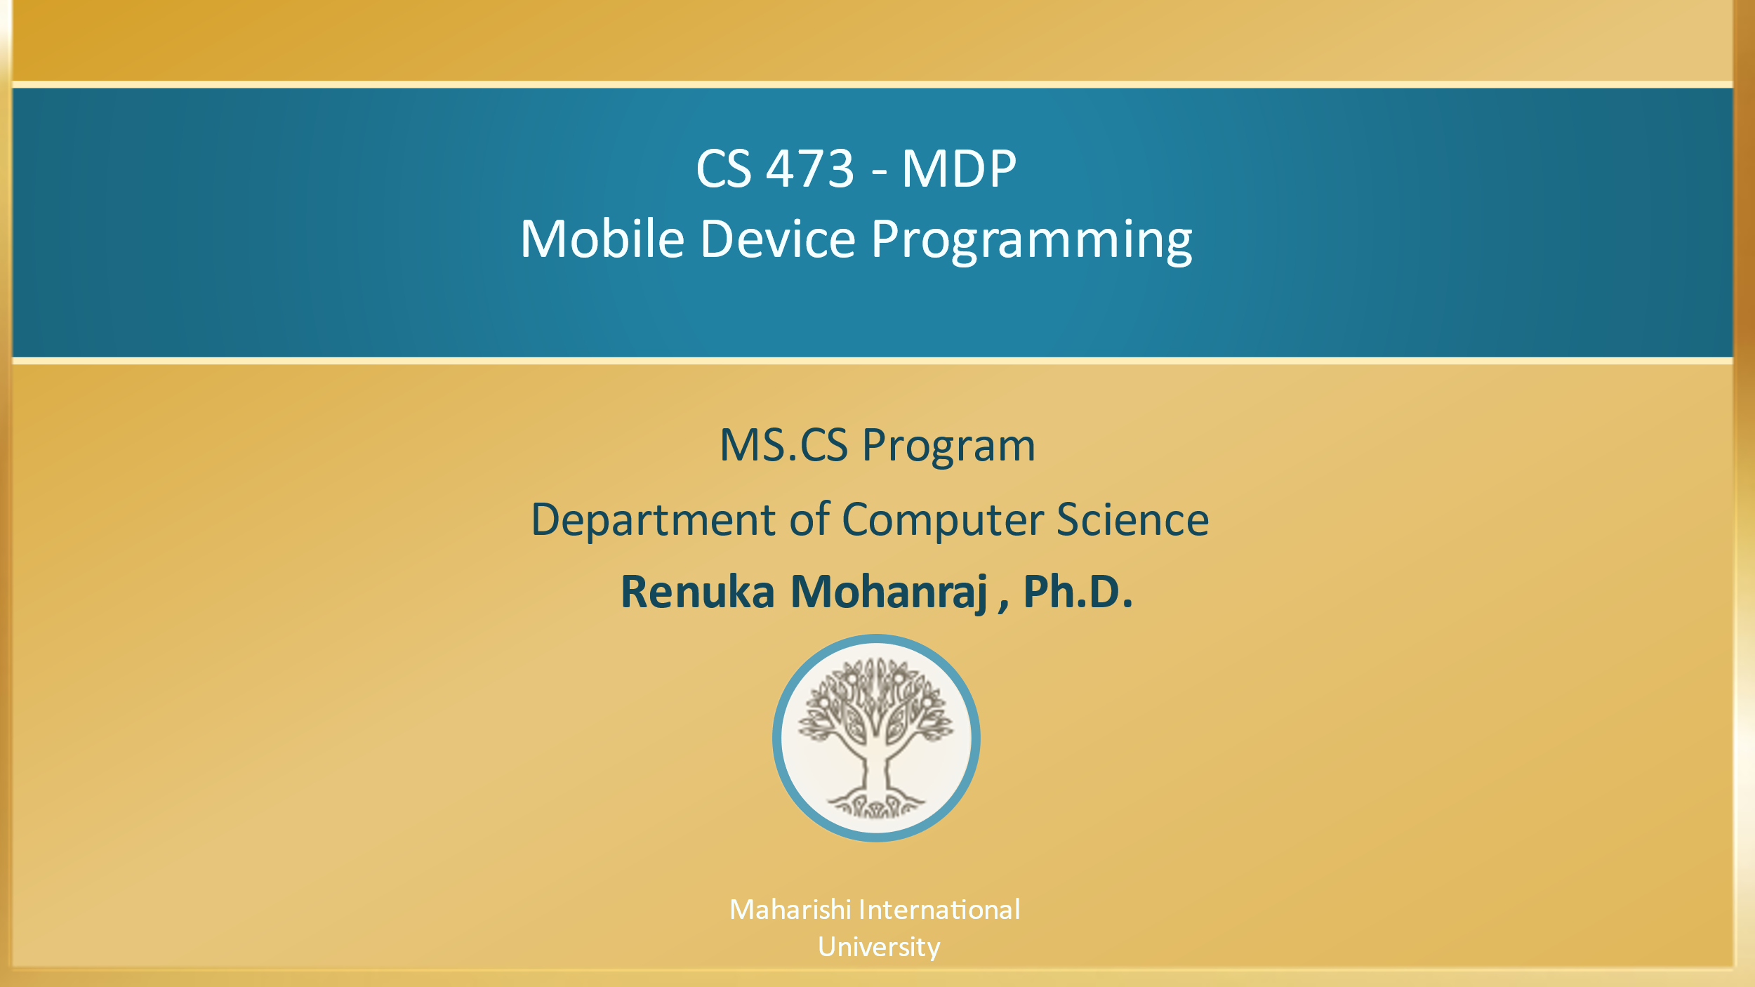

Slide 3

BALA template #10
CS 473 – MDP
Mobile Device Programming
Lesson-6 User Input Controls – Day 1
Maharishi International
University

Slide 4
Wholeness
Your app's user interface is everything that the user can see and interact with. Android provides a variety of pre-built UI components such as TextView, Button, AutoCompleteTextView and various list views that allows you to build the graphical user interface for your app. Android also provides other UI modules for special interfaces such as dialogs, notifications, and menus. The ultimate provider of tools for the creation of beautiful and functional content is pure intelligence itself; all creativity arises from this field’s self-interacting dynamics.

Slide 5
Agenda
Day 1
Input Controls- Text and Buttons
AutoCompleteTextView
Toast Message
Spinner
ListView
Dialogs – Alert, DatePicker, Time Picker
Hands on Examples
Day 2
Recycler View and CardView

Slide 6
Users expect to interact with apps
Clicking, pressing, talking, typing, and listening
Using user input controls such buttons, menus, keyboards, text boxes, and a microphone
Navigating between activities

Slide 7
User interaction design
Important to be obvious, easy, and consistent:
Think about how users will use your app
Minimize steps
Use UI elements that are easy to access and understand
Follow Android best practices
https://developer.android.com/distribute/best-practices
Meet user's expectations

Slide 8
Ways to get input from the user
Free form
Text and voice input
Actions
Buttons
Contextual menus
Gestures
Dialogs
Constrained choices
Pickers
Checkboxes
Radio buttons
Toggle buttons
Spinners
Notes:
Text fields that are “free form” (not validated by a lookup), allow you to enter a value directly into the field prompt.

Slide 9
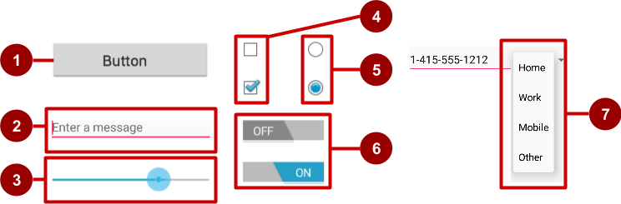
Examples of user input controls
Button
Text field
Seek bar
Checkboxes
Radio buttons
Toggle
Spinner
The View class is the basic building block for all UI components, including input controls
View is the base class for classes that provide interactive UI components
View provides basic interaction through android:onClick

Slide 10
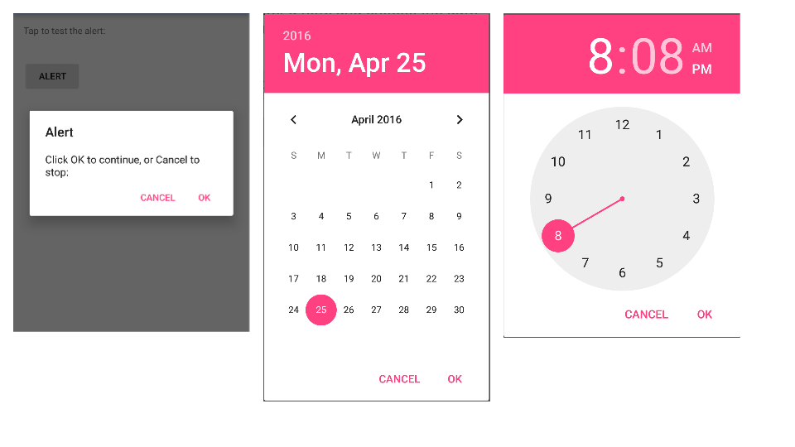
Alert dialog, date picker, time picker

Slide 11
EditText
EditText class used to accept inputs from the user
Multiple lines of input
Characters, numbers, and symbols
Spelling correction
Tapping the Return (Enter) key starts a new line
Customizable
Get the EditText object for the EditText view
EditText simpleEditText = (EditText) findViewById(R.id.edit_simple);
Retrieve the CharSequence and convert it to a string
String strValue = simpleEditText.getText().toString();

Slide 12
Common input types
textShortMessage—Limit input to 1 line
textCapSentences—Set keyboard to caps at beginning of sentences
textAutoCorrect—Enable autocorrecting
textPassword—Conceal typed characters
textEmailAddress—Show an @ sign on the keyboard
phone—numeric keyboard for phone numbers
textPersonName – allow single line of Input
Example
android:inputType="phone"
android:inputType="textAutoCorrect|textCapSentences"

Slide 13
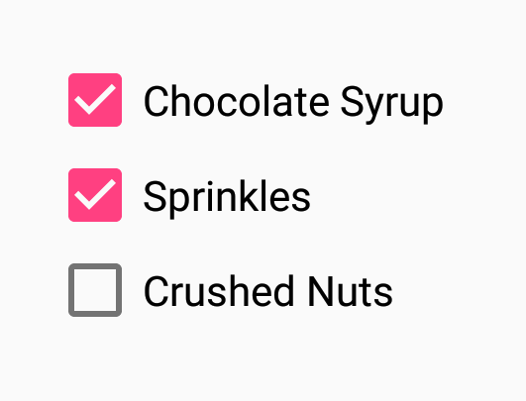
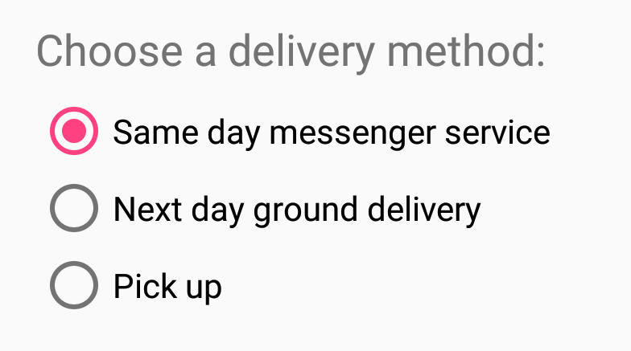
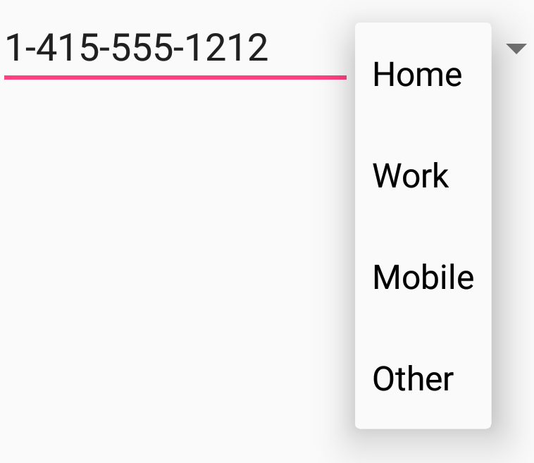


Making Choices
Checkboxes
Radio buttons
Spinner
Toggles
Switch

Slide 14
Radio buttons
User can select one of several choices
Put radio buttons in a RadioGroup
Checking one unchecks another
Put radio buttons in a vertical list or horizontally if labels are short
Every radio button can have an onClick handler
Commonly used with a submit button for the RadioGroup

Slide 15
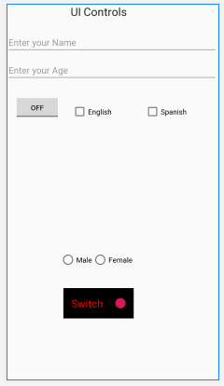
Hands on Exmaple – 1 – UI Controls
Refer : UIDemo to know about UI Components and their click events.

Slide 16
Main Point 1
There are number of input controls that can be used including Button, EditText, Checkbox, Radio Button, Toggle Button, Spinner and Picker to develop an app with interactive UI’s. Similarly Creative Intelligence synthesizes parts for completeness of living through the interaction of inner self by doing regular transcendental mediation.

Slide 17
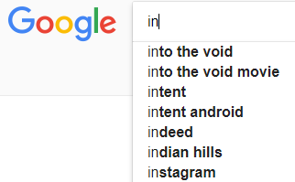
AutoCompleteTextView
The AutoCompleteTextView is sort of a hybrid between the EditText (field) and the Spinner. With auto-completion, as the user types, the text is treated as a prefix filter, comparing the entered text as a prefix against a list of candidates.
Matches are shown in a selection list that folds down from the field. The user can either type out an entry (e.g., something not in the list) or choose an entry from the list to be the value of the field.
In addition, AutoCompleteTextView has a Threshold property, to indicate the minimum number of characters a user must enter before the list filtering begins.
To create a UI Component use <AutoCompleteTextView> tag in XML.
To provide an auto completion support to the user first we must configure the values. Configure the values either using
XML approach or Kotlin code approach.

Slide 18
XML Approach
Step 1: In your Android Project go to the folder app→res→values→strings.xml
Set the values by using the given lines of codes
<string-array name=“array_name”>
<item>value1</item>
<item>value2</item>
………….
</string-array>
Step 2: Create an AutoCompleteTextView UI component in XML with an id.
Step 3: Use the following code to get the Xml configured String values into your Activity.
String[] values=getResources().getStringArray(R.array.array_name);

Slide 19
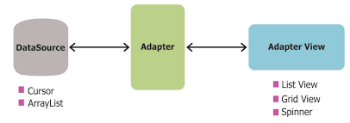
XML Approach
Step 4: for presenting the values we need to create an Adapter. In Android there are various types of Adapters available such as ArrayAdapter, Custom Adapter(Customizing ListView, GridView), Cursor Adapter(Work with Database) etc., In this
lesson, we are using ArrayAdapter.
Adapter : An Adapter object acts as a bridge between an AdapterView and the underlying data for that view. The Adapter provides access to the data items. The Adapter is also responsible for making a View for each item in the data set.

Slide 20
XML Approach
var adapter= ArrayAdapter<String>(context, Layout_Resorce File, values);
// To specify the Adapter Object. Here actv is an AutocompleteTextView object
actv.setAdapter(adapter);
// To specify the dropdown support, after how many characters of user entry
actv.setThreshold(int);
Context : It allows access to application-specific resources and classes, as well as up-calls for application-level operations such as launching activities, broadcasting and receiving intents, etc. Mostly use this or getApplicationContext().

Slide 21

Hands-on-Example-2– Countries list using ACTV
strings.xml
<resources> <string name="app_name">ACTVDemo</string> <string-array name="countries"> <item>India</item> <item>Indonasia</item> <item>USA</item> <item>Asia</item> <item>Africa</item> <item>Siria</item> <item>Sri Lanka</item> <item>Canada</item> <item>Koria</item> <item>Island</item> <item>Bangaladesh</item> <item>Nepal</item> </string-array> </resources>

Slide 22
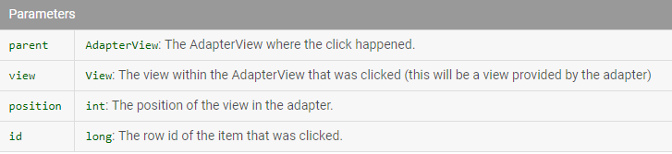
AdapterView.OnItemClickListener
interface AdapterView.OnItemClickListener {
// Callback method to be invoked when an item in this AdapterView has been clicked.
onItemClick(parent: AdapterView<*>, view: View, position: Int, id: Long);
} (*) indicates like (?) wildcard in Java
Implementers can call getItemAtPosition(position) if they need to access the data associated with the selected item.
A position starts from 0 for ListView, If you are using an ArrayAdapter, position and id become the same, whereas to get a proper row id it is important that the cursor, which was passed to the adapter, contains unique id for each row in the table.

Slide 23
MainActivity.kt
class MainActivity : AppCompatActivity() {
private lateinit var strings : Array<String>
override fun onCreate(savedInstanceState: Bundle?) {
super.onCreate(savedInstanceState)
setContentView(R.layout.activity_main)
strings = arrayOf ("Asia","Australia","America","Belgium","Brazil","Canada",
"California","Dubai","France","Paris")
// Get the XML configured vales into the Activity and stored into an String Array
//strings = getResources().getStringArray(R.array.countries);
/* Pass three parameters to the ArrayAdapter
1. The current context, 2. The resource ID for a built-in layout file containing a TextView
to use when instantiating views, which are available in android.R.layout
3. The objects to represent in the values */
val adapter = ArrayAdapter<String>(this, android.R.layout.simple_spinner_item, strings)
actv.setAdapter(adapter)
actv.threshold = 1
Notes:
void onItemClick (AdapterView<?> parent, View view, int position, long id)
Parameters
Parent - AdapterView: The AdapterView where the click happened.
View: The view within the AdapterView that was clicked (this will be a view provided by the adapter)
Position - int: The position of the view in the adapter.
Id: long: The row id of the item that was clicked.

Slide 24
MainActivity.kt
// Set an item click listener for auto complete text view
actv.onItemClickListener =
AdapterView.OnItemClickListener {
parent, view, position, id ->
Toast.makeText(this,
"Item selected is " +
parent.getItemAtPosition(position),
Toast.LENGTH_LONG).show()
}
}
}
Refer : ACTVDemo

Slide 25
Toast
Toast is one of the notification method in Android which is used to display text on the screen for few seconds at the bottom.
Toast makeText (Context context, CharSequence msg, int duration).show()
Example
Toast.makeText(applicationContext,"Hello Toast",Toast.LENGTH_SHORT).show()
Toast.makeText(this,"Hello Toast",Toast.LENGTH_LONG).show()
Parameters
context | Context: The context to use. Usually, your Application or Activity object.
msg | CharSequence: The text to show. Can be formatted text.
duration | int: How long to display the message. Either LENGTH_SHORT(1sec) or LENGTH_LONG(3 sec)

Slide 26
Toast
To print the Toast in different position, use the following code.
Use different position such as BOTTOM, LEFT, RIGHT, TOP and CENTER with x,y coordinates
var tst = Toast.makeText(applicationContext,
“My Toast",
Toast.LENGTH_LONG)
tst.setGravity(Gravity.TOP, 0, 0)
tst.show()

Slide 27
Difference Between XML And Kotlin Approach for providing data resources
XML Approach
To provide static data
Example : Country names are static
To provide Multi language support-I18N-(Internationalization) -(Discussed later in Localization)
Kotlin code Approach
To provide dynamic data
Example : Movie's list

Slide 28
Spinners
Spinners provide a quick way to select one value from a set. In the default state, a spinner shows its currently selected value.
Touching the spinner displays a dropdown menu with all other available values, from which the user can select a new one.
Spinners scroll automatically if necessary
Implementing a spinner needs to follow the below steps
Create Spinner UI element in the XML layout
Define spinner choices in an array(Kotlin/Strings.xml resource)
Create an adapter with default spinner layouts
Attach the adapter to the spinner
Implement onItemSelectedListener method
Notes:
Remove this line from your AndriodManifest.xml
<application android:label="@string/app_name">

Slide 29
Creating Spinner
<Spinner android:id="@+id/planets_spinner" android:layout_width=“match_parent" android:layout_height="wrap_content“
android:entries="@array/planets_array"/>
Android:entries helps to retrieve the values from string resources to the xml.
Configure the values either using XML approach or Kotlin code approach

Slide 30
Populate the spinner choices using Resources
Step 1: In your Android Project go to the folder app→res→values→strings.xml
<?xml version="1.0" encoding="utf-8"?> <resources> <string-array name="planets_array"> <item>Mercury</item> <item>Venus</item> <item>Earth</item> <item>Mars</item> <item>Jupiter</item> <item>Saturn</item> <item>Uranus</item> <item>Neptune</item> </string-array> </resources>

Slide 31
Populate the spinner with user choices
The choices you provide for the spinner can come from any source, but must be provided through SpinnerAdapter, such as an ArrayAdapter if the choices are available in an array or a CursorAdapter if the choices are available from a database query.
For instance, if the available choices for your spinner are pre-determined, you can provide them with a string array defined in a string resource file:
<?xml version="1.0" encoding="utf-8"?> <resources> <string-array name="planets_array"> <item>Mercury</item> <item>Venus</item> <item>Earth</item> <item>Mars</item> <item>Jupiter</item> <item>Saturn</item> <item>Uranus</item> <item>Neptune</item> </string-array> </resources>

Slide 32
Responding to user selections
When the user selects an item from the drop-down, the Spinner object receives an on-item-selected event.
To define the selection event handler for a spinner, implement the AdapterView.OnItemSelectedListener interface and the corresponding onItemSelected() callback method.
The AdapterView.OnItemSelectedListener requires the onItemSelected() and onNothingSelected() callback methods.
Then you need to specify the interface implementation by calling setOnItemSelectedListener():
Example from Demo : SpinnerDemo folder

Slide 33
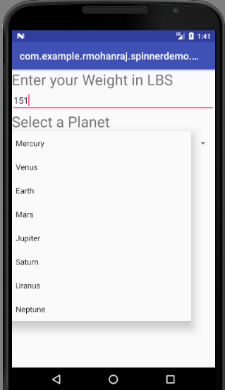
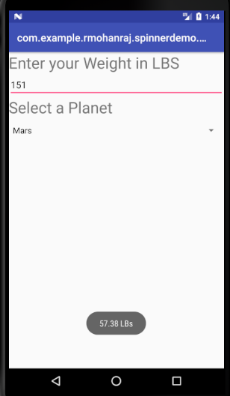
Hands on Example-3 for Spinner - Planet Weight Calculator

Slide 34
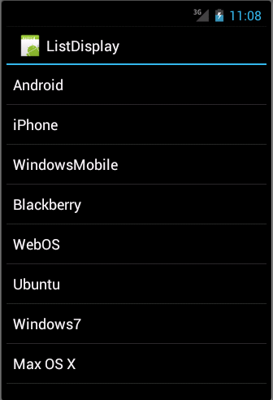
Simple ListView
ListView is a view group that displays a list of scrollable items. An Adapter that pulls content from a source, such as, a query or an array, helps to insert the list items automatically.
Each item result is converted into a View and added to the list by the Adapter.
<ListView android:id=“@android:id/list” android:layout_width=“match_parent” android:layout_height=“wrap_content”
</ListView>
Example : ListViewPlanet

Slide 35
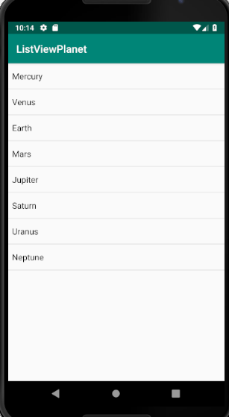
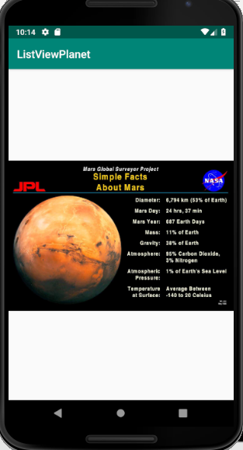
Hands on Example-4 - ListView Planet Information

Slide 36
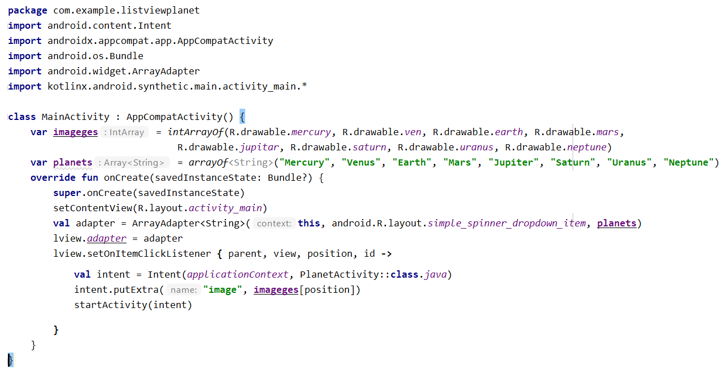
ListView Code

Slide 37
Main Point 2
Auto Complete View is an editable text view that shows completion suggestions automatically while the user is typing. The list of suggestions is displayed in a dropdown menu from which the user can choose an item to replace the content of the edit box with. Science of Consciousness: "If a man is able to submit himself to nature, then nature will react to his needs automatically”.
Spinners provide a quick way to select one value from a set. In the default state, a spinner shows its currently selected value. Touching the spinner displays a dropdown menu with all other available values, from which the user can select a new one. ListView is a ViewGroup that creates a list of scrollable items. The list items are automatically inserted to the list using a ListAdapter, and listener find out when the selection has made. Science of Consciousness: "Similarly every person having their own list of aims and choices in their life. Transcendental meditation is works like Android event listener what one wants to do in a better way, in a right way, for maximum results."

Slide 38
Android Dialogs
Dialogs are prompt or alert displayed to the user to take a decision or to input any information. The dialogs are also used to notify user when a task has been completed. It does not fill the entire screen and usually appears when a user must take a particular action before proceeding.
Android supports different types of Dialogs
Alert Dialog
Date Picker
Time Picker
Custom Dialog
Progress Dialog
Dialog Fragment

Slide 39
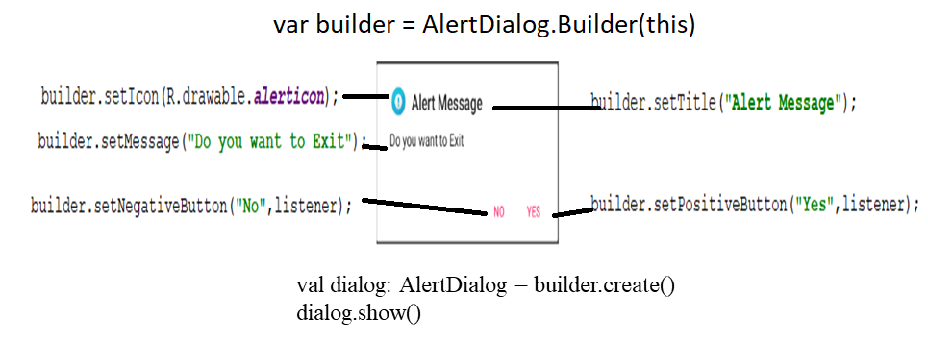
Alert Dialogs Example
Alert Dialog is one of the built-in Dialog box with few functionalities like title, message and icon.
We can create three possible choices of buttons (setPositiveButton(), setNegativeButton() and setNeutralButton(). Refer Demo : AlertDemo.
For more info https://developer.android.com/guide/topics/ui/dialogs.html
Sample alert dialog

Slide 40
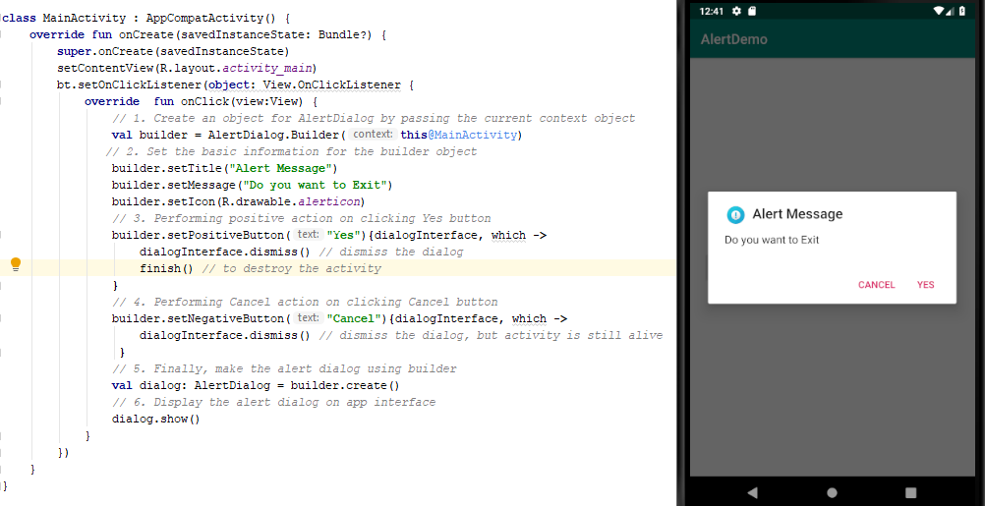
Hands on example – 4 -Alert Dialogs Code and Screen shot

Slide 41
Date and Time Picker Dialogs
DatePickerDialog and TimePickerDialog classes have onDateSetListener() and onTimeSetListener()callback methods, respectively.
These callback methods are invoked when the user is done with selecting the date and time, respectively.
The DatePickerDialog class consists of a 5-argument constructor with the parameters listed below.
1. Context: It requires the application context

Slide 42
Date and Time Picker Dialogs
2. CallBack Function: onDateSetListener() is invoked and need to override the given method.
void onDateSet(DatePicker view, int year, int month, int dayOfMonth);
Parameters are
view the picker associated with the dialog
year the selected year
month the selected month (0-11)
dayOfMonth selected day of the month (1-31, depending on month)
3. int mYear : It shows the current year that’s visible when the dialog pops up
4. int mMonth : It shows the current month that’s visible when the dialog pops up
5. int mDay : It shows the current day that’s visible when the dialog pops up

Slide 43
Hands on Example 5 - Date and Time Picker Dialogs
The TimePickerDialog class consists of a 5-argument constructor with the parameters listed below.
1. Context: It requires the application context
2. CallBack Function: onTimeSetListener() is invoked when the user sets the time. Need to override the method
void onTimeSet(TimePicker view, int hourOfDay, int minute);
Parameter are
view associated with this listener
hourOfDay the hour that was set
minute the minute that was set
3. int mHours : It shows the current Hour that’s visible when the dialog pops up
4. int mMinute : It shows the current minute that’s visible when the dialog pops up
5. boolean false : If its set to false it will show the time in 24 hour format else not

Slide 44
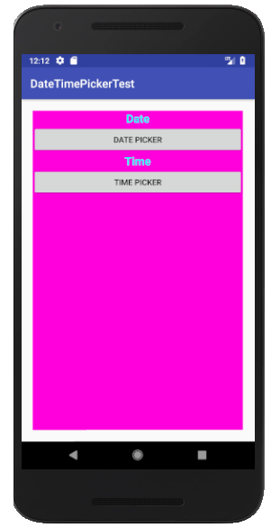
Example - Date and Time Picker Dialogs
Problem Requirement : If you click the DATE PICKER button, it will open DatePicker dialog, chosen date will be replaced with Date TextView. Similar way for TIME PICKER.
Refer : DateTimePickerDemo

Slide 45
Code for DatePicker Dialogs
// DatePicker Implementation
when(v?.id){
R.id.bt1 -> {
val c = Calendar.getInstance()
val mYear = c.get(Calendar.YEAR)
val mMonth = c.get(Calendar.MONTH) +1
val mDay = c.get(Calendar.DAY_OF_MONTH)
val dpd = DatePickerDialog(this,
DatePickerDialog.OnDateSetListener { view, year, monthOfYear,
dayOfMonth ->
// Display Selected date in Toast
tv1.text = "$dayOfMonth $monthOfYear $year"
}, mYear, mMonth, mDay)
dpd.show()
}

Slide 46
Code for TimePicker Dialogs
// TimePicker Implementation R.id.bt2 -> {
val cal = Calendar.getInstance()
val timeSetListener =
TimePickerDialog.OnTimeSetListener { timePicker, hour,
minute ->
cal.set(Calendar.HOUR_OF_DAY, hour)
cal.set(Calendar.MINUTE, minute)
tv2.text = SimpleDateFormat("HH:mm").format(cal.time)
}
TimePickerDialog(this, timeSetListener, cal.get(Calendar.HOUR_OF_DAY), cal.get(Calendar.MINUTE), false).show()
}

Slide 47
XML UI code for Date, Time Picker
<TimePicker android:id="@+id/timePicker1">
<DatePicker
android:id="@+id/datePicker1"
android:layout_width="wrap_content"
android:layout_height="wrap_content"
android:datePickerMode="calendar"/>

Slide 48
Main Point 3
A dialog is a small window that prompts the user to decide or enter additional information. Customization of views and dialogs helps to show UI’s in a better way. Science of Consciousness: TM is a common interface to perform greater activities and taking right decision in life. Also helps to customize the individual and society needs in a better way.

